Slide 1
Facial Recognition Attendance System

Slide 2
Outline
The Approach
Why Transfer Learning?
Face Detection – Haar cascades
Face recognition - vgg19
Training and Testing
Results
The final frontend

Slide 3
The Approach
3
Two-Step Approach:
Face Detection: Used to identify faces in the camera feed.
Haar cascades are used as they can efficiently locate faces in images/videos.
Facial Recognition: VGG19 model for recognition.
TRANSFER LEARNING with pre-trained VGG16 extract features.
A new classifier on top of VGG19 is trained for recognizing specific individuals.

Slide 4
Why Transfer Learning?
4
A well-labeled dataset is crucial for training.
A large Dataset is a must for face applications of Deep learning
The lack of such a dataset is the reason.
So we chose the best alternative available – The TRANSFER LEARNING

Slide 5
Face Detection
With Haar cascades

Slide 6
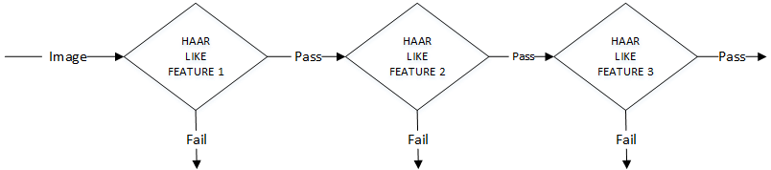
Haar Cascades
Haar Cascades are Pretrained Models tested on many false and true labeled Face Data sets
So we use this pre-trained model for face Extraction, using haar Features

Slide 7
Face recognition
With VGGNET’s vgg19

Slide 8
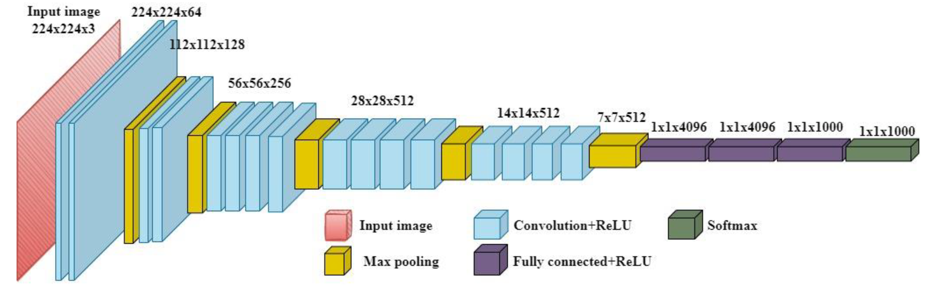
VGG19 Architecture
The last layer of 1000 neurons softmax is removed.
And the neurons are changed to no. of people that need to be recognized.

Slide 9
Training and VAlidating
Dataset: 100 images are collected for each person the system needs to recognize.
Training: These images are used to train a facial recognition model.
Transfer Learning: Pre-trained model is used as a base.
Fine-tuning: Only the last layer of the pre-trained model is trained on the dataset for specific person recognition

Slide 10
Training and VAlidation

Slide 11
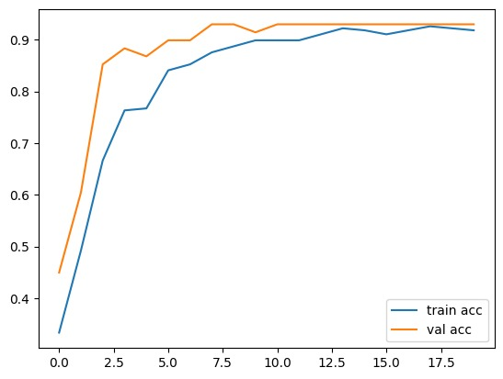
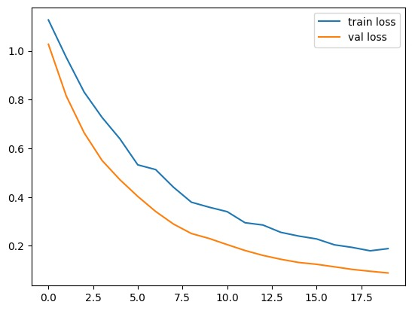
Training & Validation results

Slide 12
Final FRontend
The Saved Trained module is used through a frontend module(A python file)
The Frontend module when ran recognizes the faces and annotates the frames from the cam feed
Attendance is marked into an excel file for the corresponding face detected

Slide 13
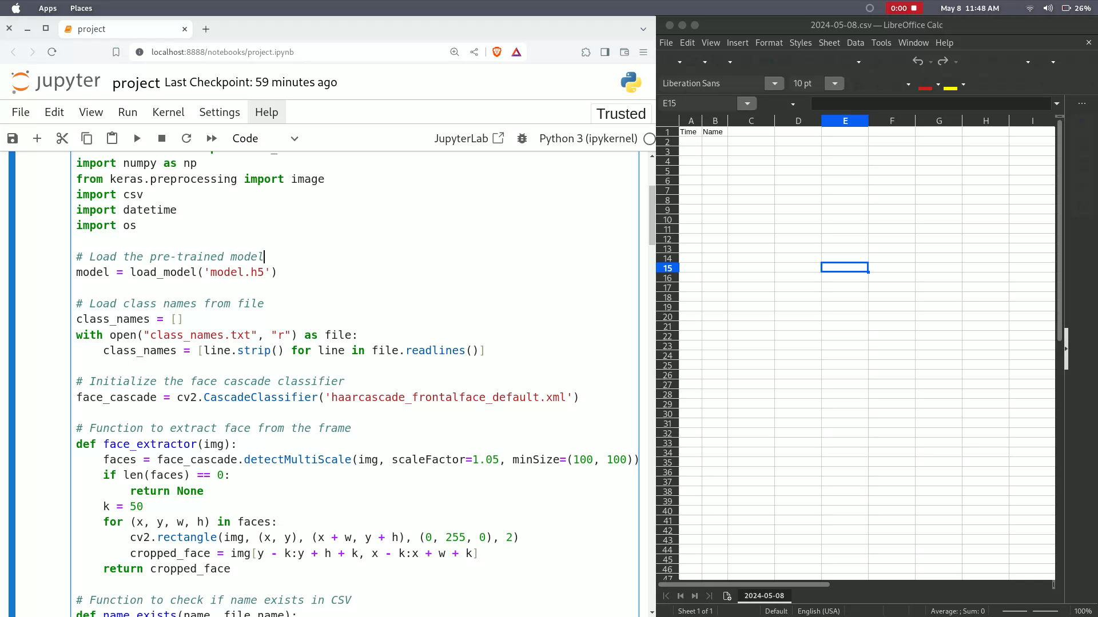
Final Frontend Performance

Slide 14
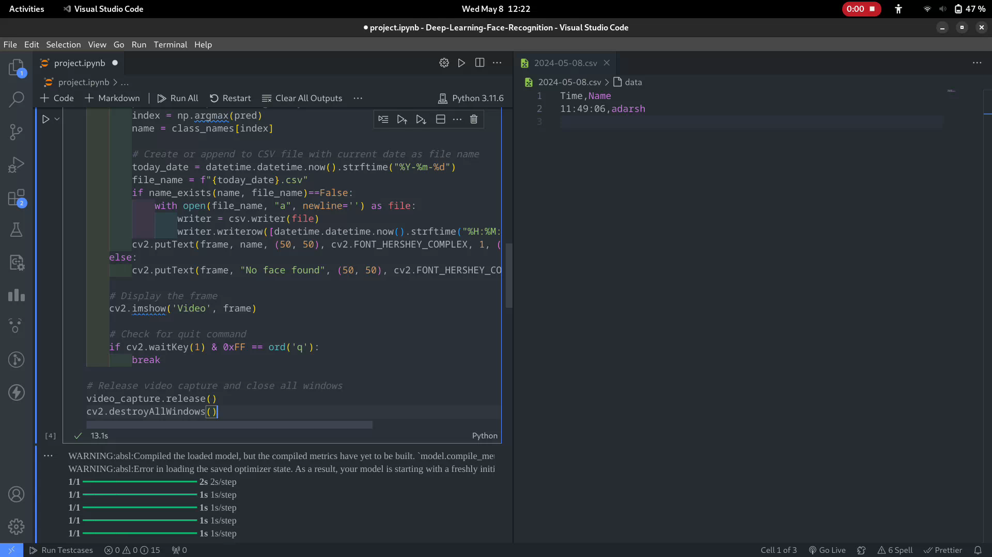
Final Frontend Performance

Slide 15
Thank you
Group Members
Ponnuru Aadarsh
Vedurupaka Venkatasai
Gayathri

